Slide 1
Transistor Construction and Operation

Slide 2
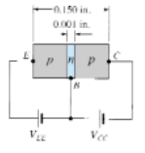
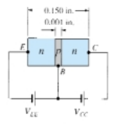

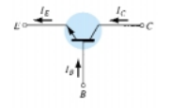
3.2 TRANSISTOR CONSTRUCTION
simbol
(a)
(b)
Figure 3.2 Types of transistors: (a) pnp; (b) npn

Slide 3
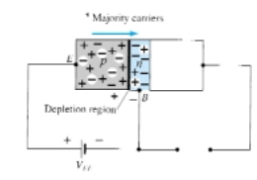
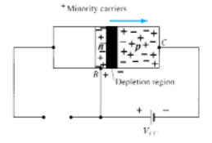

3.3 TRANSISTOR OPERATION
Figure 3.4 Reverse-biased junction of a pnp
transistor

Slide 4
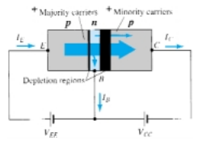

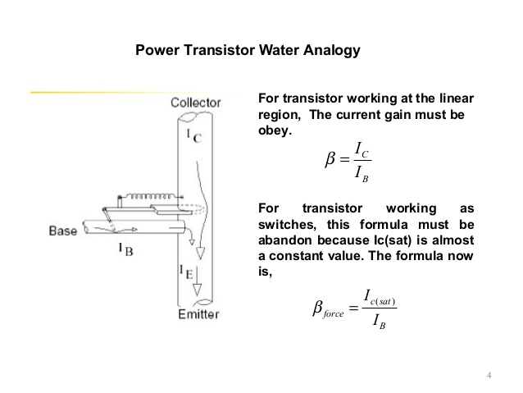

Fig. 3.5. The minority-current component is called the
leakage current and is given the symbol ICO (IC current with emitter terminal Open).
Figure 3.5 Majority and minority carrier flow of a pnp transistor
One p-n junction of a transistor is reverse biased, while the other is forward biased
Applying Kirchhoff’s current law to the transistor of Fig. 3.5

